Slide 1
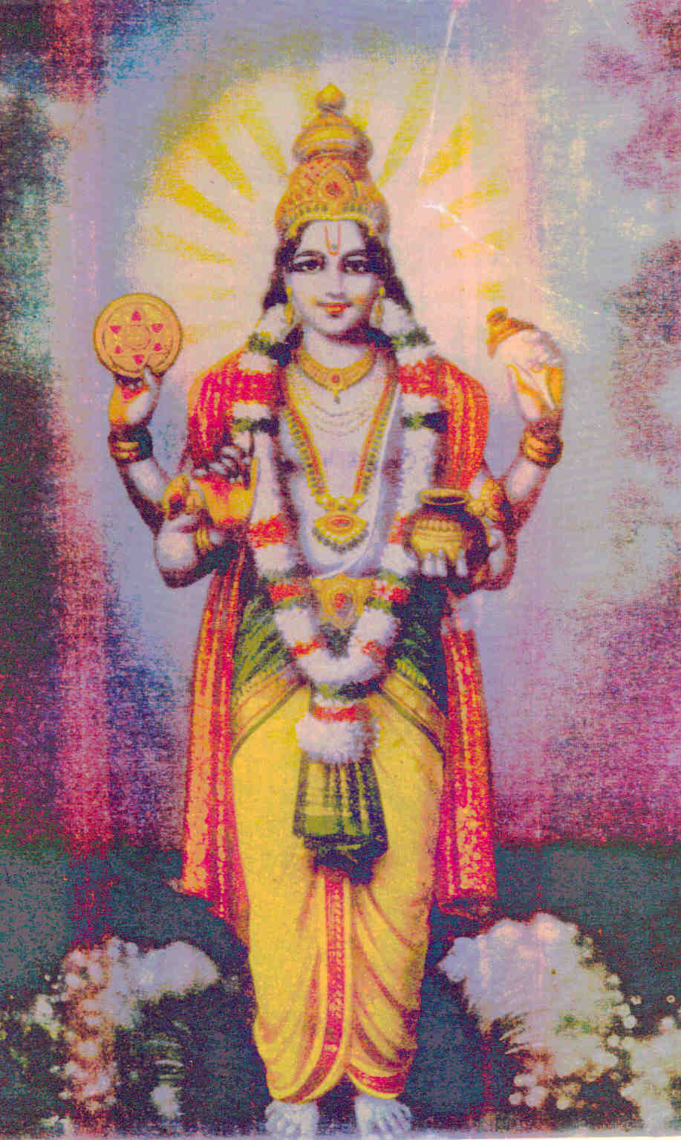

LORD DHANVANTARI

Slide 2
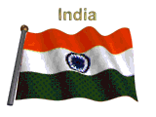

My experiences at CCRAS & way ahead
Prof. Dr. G.S.LAVEKAR,
FORMER DIRECTOR GENERAL,
CCRAS-AYUSH
Ministry, Govt. of India
gslavekar@gmail.com
+918826711841

Slide 3
Experience
Experience is the knowledge or mastery of an event or subject gained through involvement in or exposure to it. Terms in philosophy such as "empirical knowledge = Experience based knowledge“. It is uncountable noun.
दृष्टम अल्पम अदृष्टम अनल्पम - चरक

Slide 4
Good Experience=Work
Publications – Clinical Research Protocols, Panchakarma , E-Samhita and Nighantu etc.
Up gradation of Institutes
Promotions and Policy
New Recruitments
GTP
RCH
Institute Buildings and Infra structure
Laboratory Facilities
Pharmacopoeia Work
Exotic Drugs-Plants = All Herbs, Plants are Ayurvedic

Slide 5
Good Experience=Work Continue…………
Ayush- QOL-2-C
Ayush Manas
Ayush-SL = for Filariasis
Ayush-D for D.M.
Ayush Rasayan A and B
Ayush-A for Br. Asthma
Ayush C-1 Oil for Wound- Shorea Robusta-Shal Fruit Oil
Ayush K-1 for Kidney Care
Many more……

Slide 6
Scientist
Love science- Devotion and Dedication
Scientific Methods
Expert in his subject along with knowledge of related sciences- expert in one or more subjects
एकं शास्त्रं अधियानो न विद्यात शास्त्र विनिच्छयात I
तस्मात् बहुश्रुत शास्त्रं विजानिया चिकित्सकः II
Markers- Bio, Chem, Disease, DNA-Bar coading etc.
Scientific attitude = Temper, Approach to investigations …

Slide 7
Scientific attitudes
includes
Respect for evidence = Ayurveda
Honesty = Integrity, Ethics
Creativity = Inventiveness, New Idea
Flexibility = Willingness to change
Curiosity = Strong desire to learn
Objectivity = Lack of bias and
Communication = Related Scientist, Papers etc.

Slide 8
Respect for evidence = Ayurveda-Observational / Experienced science
EBS = Evidence Based Science - Medicine
आयुर्वेदोपुदेशेषु विधेय परमादर: ....
Turmeric, Ginger, Withania Somnifera
Different Markers

Slide 9
Honesty = Integrity, Ethics - One has to follow the Scientific methods
Manipulation is not permitted in Research
Negative findings are also equally important

Slide 10
Creativity = Inventiveness, New Idea
Undiscovered properties of herbs, drugs
New dosage forms
Bringing classical procedures into practices –like Oil Pooling = Gandush dharan etc.
Recently, it has been recognized that oral infection, especially periodontitis, may affect the course and pathogenesis of a number of systemic diseases, such as cardiovascular disease, bacterial pneumonia, diabetes mellitus, and low birth weight.
Abhyangam = नित्यं अभ्यंगम आचरयेत - वाग्भट
New Devices- Panchakarma, Fistula etc.

Slide 11
Flexibility = Willingness to change
Change is the universal truth
Different research designs
Fixed designs are normally theory driven
Flexible designs allow for more freedom
Exploratory research studies are also termed as formulative research studies. The main purpose of such studies is that of formulating a problem for more precise investigation or of developing the working hypotheses from an operational point of view. The major emphasis in such studies is on the discovery of ideas and insights.

Slide 12
Curiosity
Passion to explore
strong desire to know or learn something.
one's desire to invest time and energy into learning about concept
The Force Within a Hungry Mind
Endeavor - to exert oneself to do the task
"The important thing is not to stop questioning. Curiosity has its own reason for existing." -- Albert Einstein
curiosity makes learning more effective and enjoyable. Curious students not only ask questions, but also actively seek out the answers. Without curiosity, Sir Isaac Newton would have never formulated the laws of physics, Alexander Fleming probably wouldn't have discovered penicillin, and Marie Curie's pioneering research on radioactivity may not exist.

Slide 13
why is curiosity so important?
It makes your mind active instead of passive
It makes your mind observant of new ideas
It opens up new worlds and possibilities
It brings excitement into your life

Slide 14
Objectivity = Lack of bias and
Reality
impartiality,
absence of bias/prejudice,
fairness, fair-mindedness,
equitableness,
equitability, even-handedness,
justness,
justice, open-mindedness,
disinterest,
detachment, dispassionateness,
neutrality“
Research is the search for truth, truth and only truth

Slide 15
Communication = Related Scientist, Papers etc.
World is small in this computer age, so should be connected with all related resources
Ancient / Classical Scripts or Literature
Researchgate
LinkedIn
Academic Key
American Botanical Council
NIH- USA
Different magazines
Different related websites –
NIN
IVR
Indian Academy of Science
Google- Searching

Slide 16
Way ahead CCRAS-Suggestions
Infra Structure Development
New Drug Development –GTP
RCH
Drugs in Pipe line
Filariasis- Joint Research Project with ICMR-
Antidandruff-Jabalpur University -Veterinary
Panchakarma Instruments
Joint Research Projects with Institutes and Pharmaceutical Industries-
Antarctica Tea and Laddu
Nimbidin –Psoriasis, Peptic Disease and Male Contraceptive
Drug and Cosmetic Acts Books -56 (Some Books are not Available, may be published)
All Nighantus (are not Available, may be published with translation in Hindi and English)

Slide 17
Continue……..
Nano Technology
Drug delivery through Patch = Lepa
Anushastra Karmas = Minimal Invasive Para Surgical Measures
Ras Shastra
Classical Drugs Trials
Sports medicine
Diet and Diseases
Ayurveda Veterinary Medicine
Vriksha Ayurveda
Ayurveda Cosmetics
H.R. Development Institute
MDR T.B.
Ayurveda Clinics in Embassies
Ayurveda Training to Other Medical Pathy Doctors- Exa. CCRAS and Red Cross Society a joint Ayurveda Prog. For common people.

Slide 18
My ahead… some specific cases ……….
Bharat Ratna awardee C.N.R. Rao, has said that his life is dedicated to India.“Even at the age of 83, I have been receiving offers from many nations to work for them … but it is my strong commitment to serve my nation till my last breath,”
The Australian scientist, David Goodall 102-year-old scientist has vowed to keep working until his last breath.
APJ Abdul Kalam, being fondly remembered by many, spending his last breath inspiring others as he had done throughout his life.
Albert Einstein, until his last breath he worked on a new theory, the unified field theory, which however was not successful.

Slide 19
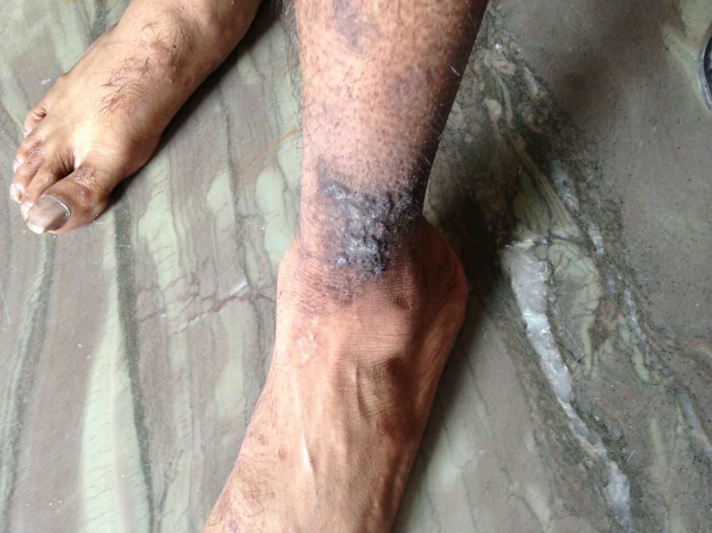
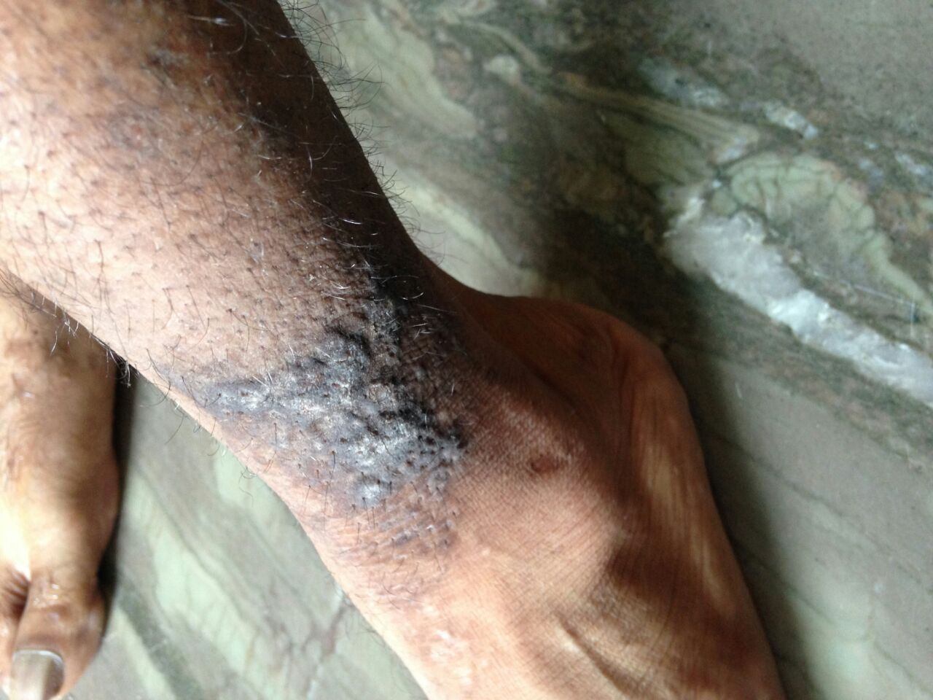
Keratosis
Before Treatment
POST – RETIREMENT SELECTED WORK CONTINUE…

Slide 20
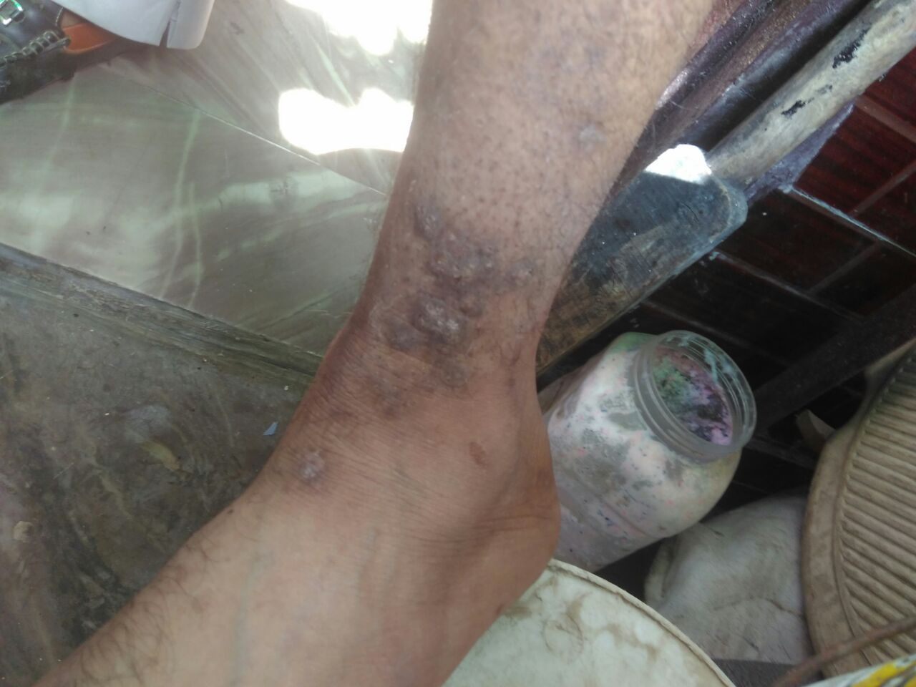
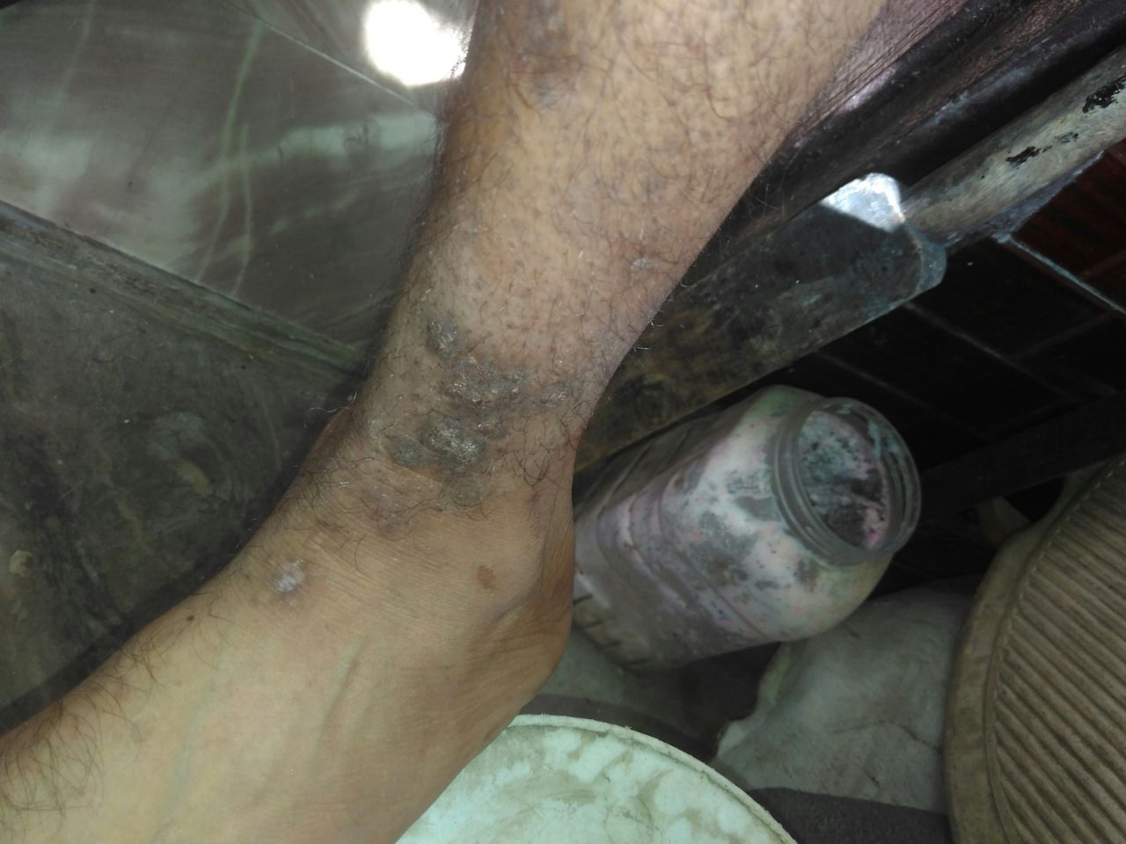
Keratosis
After two months treatment- treatment continue ….

Slide 21
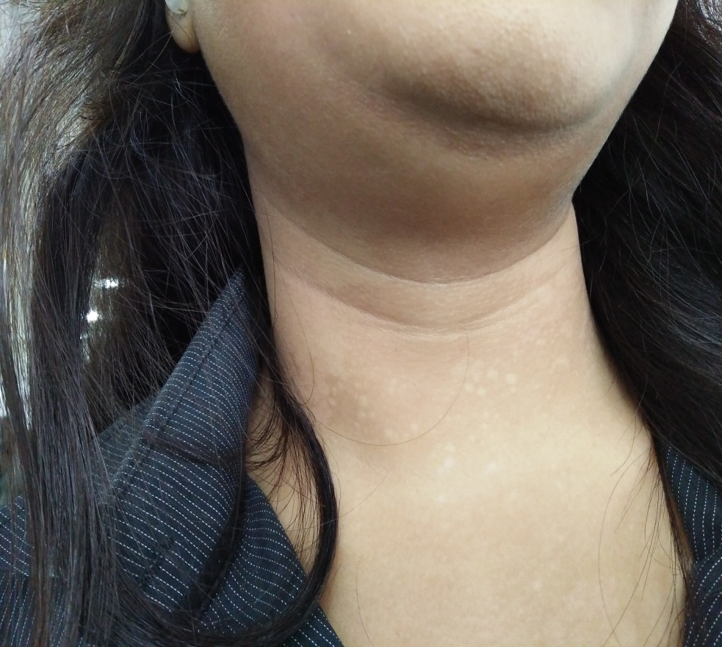
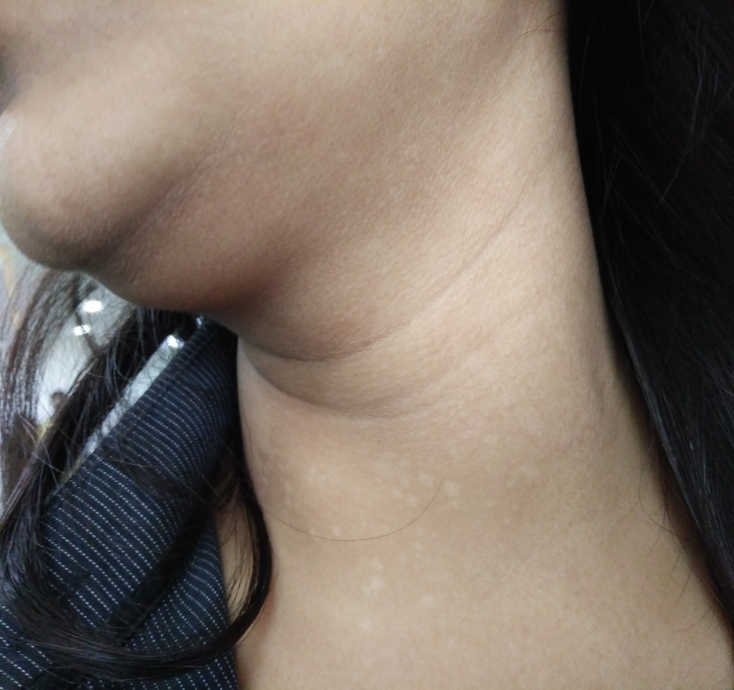
Tinea Versicolor is caused by yeast -MALASSEZIA FURFUR.
Before Treatment

Slide 22
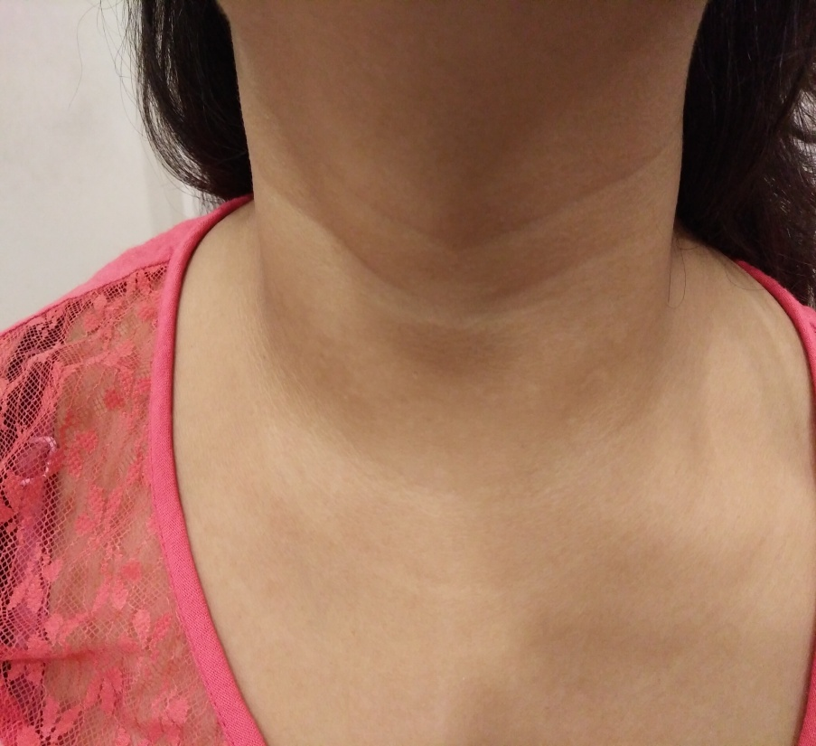
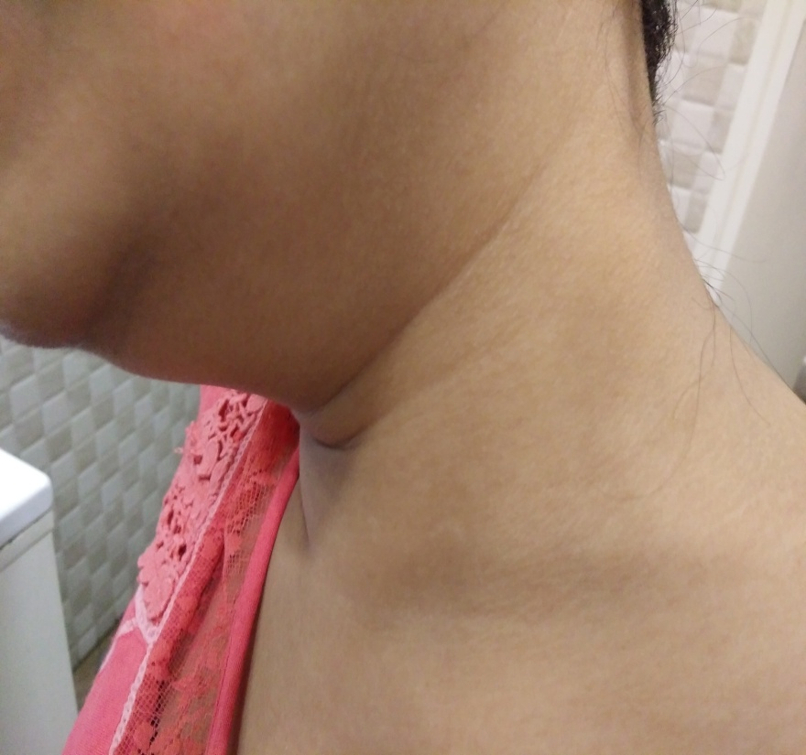
Tinea Versicolor is caused by yeast -MALASSEZIA FURFUR.
After one month Treatment

Slide 23
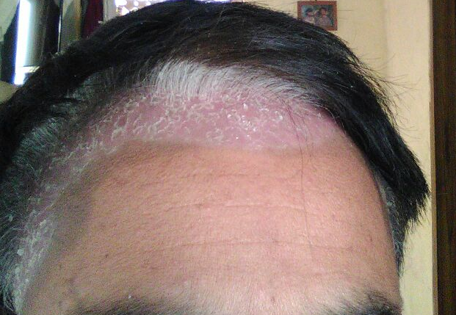
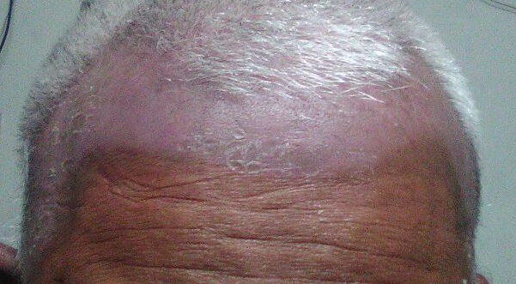
Psoriasis = Kitibha

Slide 24
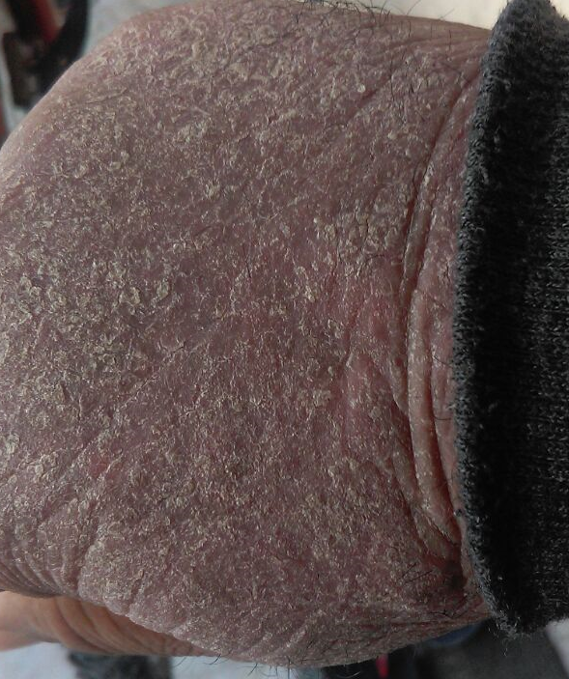
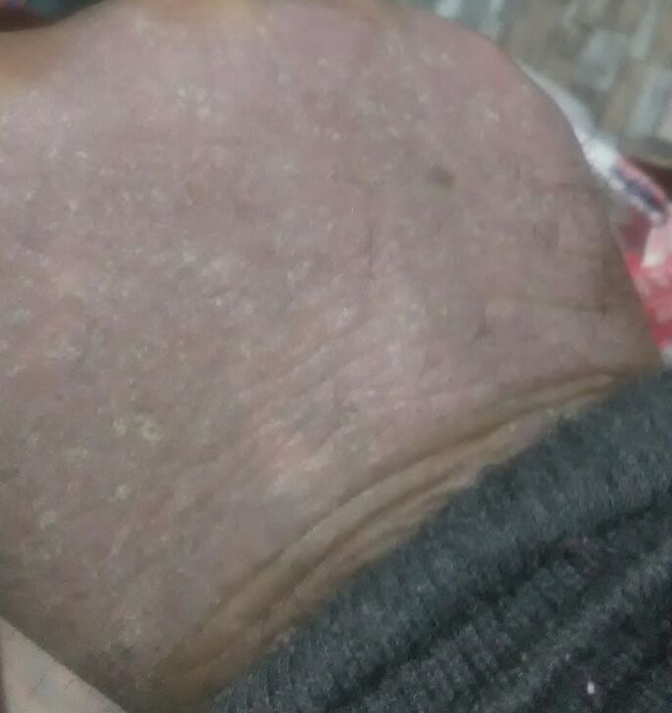
AFTER 1 MONTH
BEFORE TREATMENT -RIGHT HAND

Slide 25
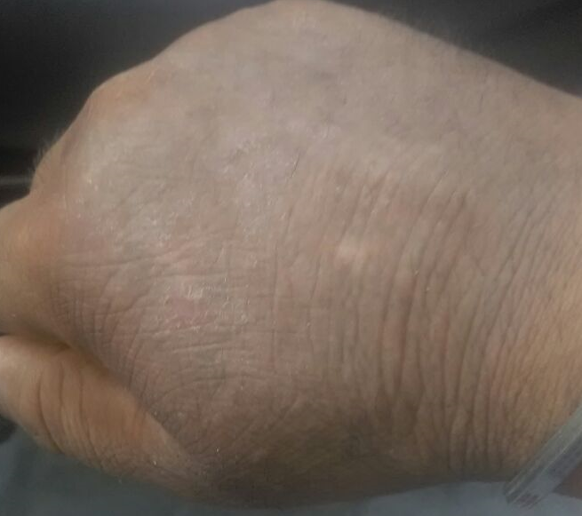
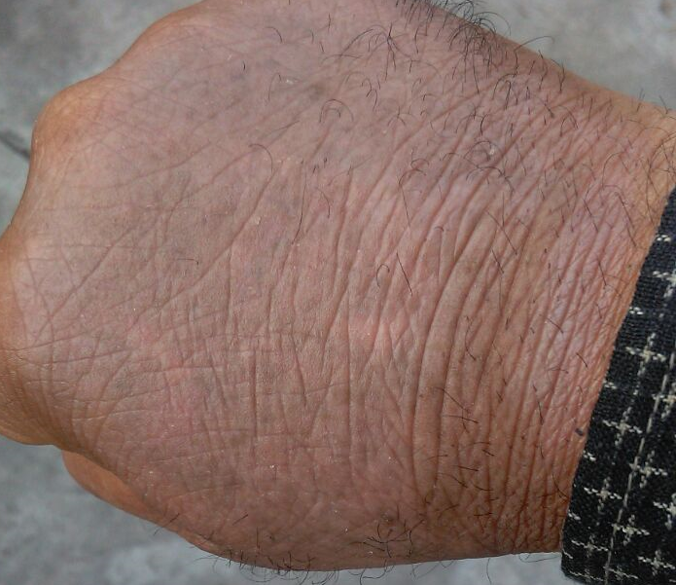
AFTER 1 MONTH 22 DAYS
AFTER 2 MONTHS 15 DAYS

Slide 26
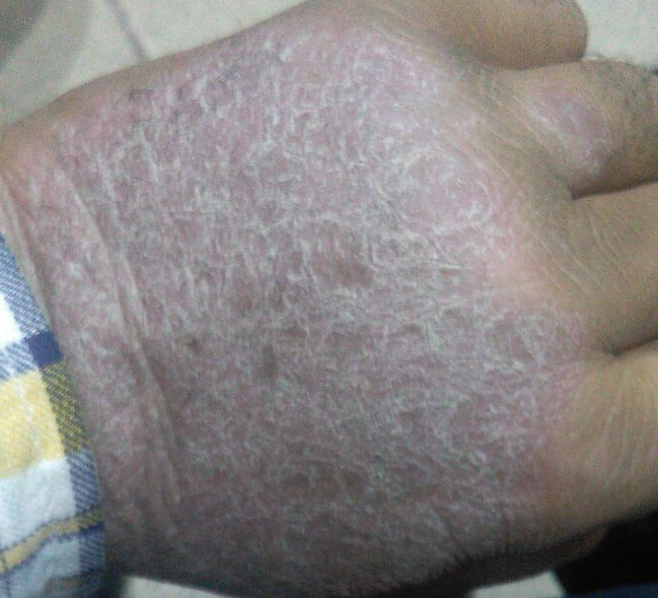
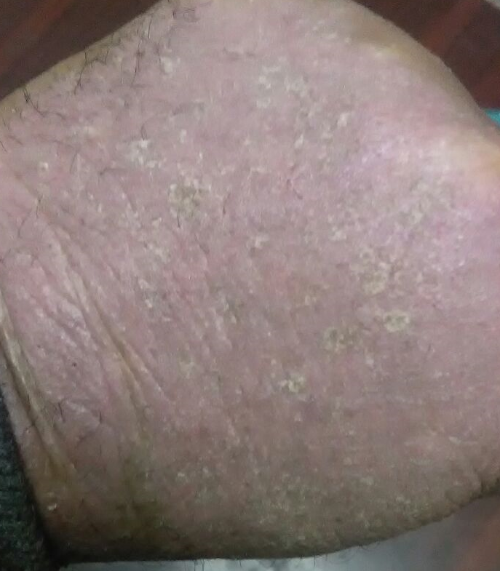
AFTER 1 MONTH
BEFORE TREATMENT -LEFT HAND

Slide 27
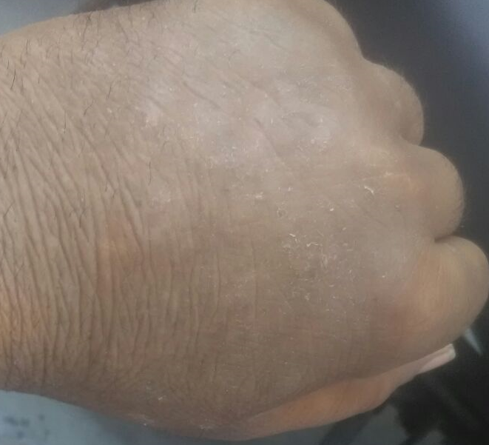
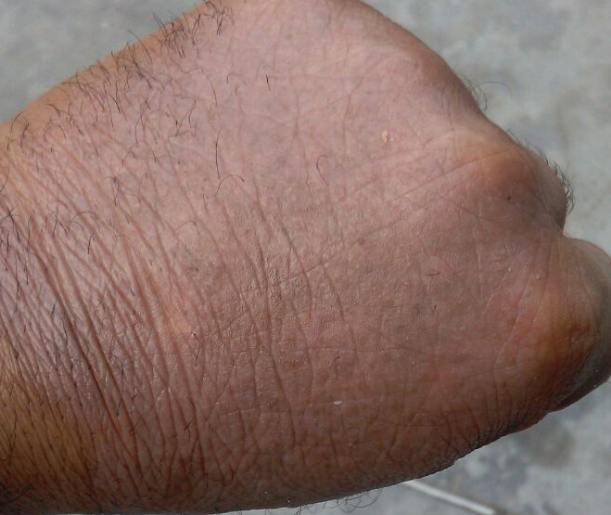
AFTER 2 MONTHS 15 DAYS AFTER 1 MONTH 22 DAYS

Slide 28
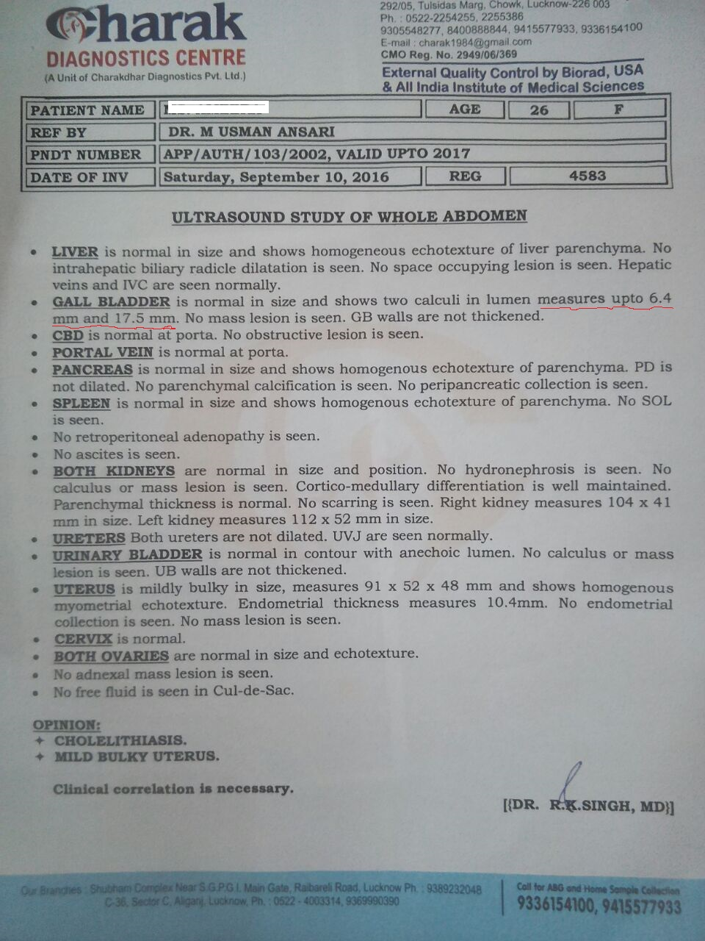
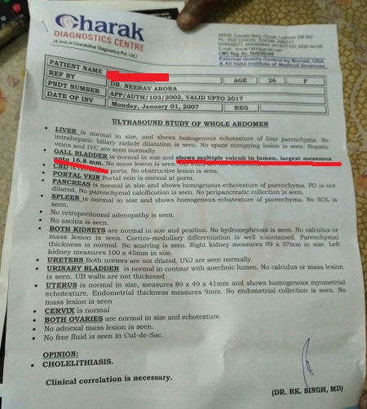
Gall Bladder Stone - Treatment Continue ….
Before – 2 Calculi measures up to 6.4 mm & 17.5 mm
During treatment –Multiple Calculi,
Largest 16.8 mm

Slide 29
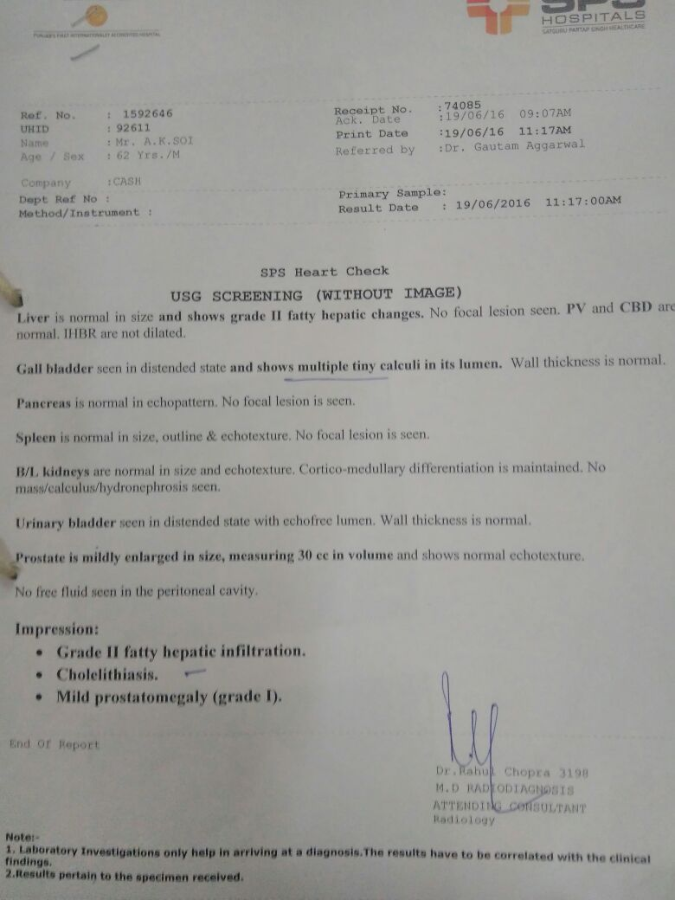
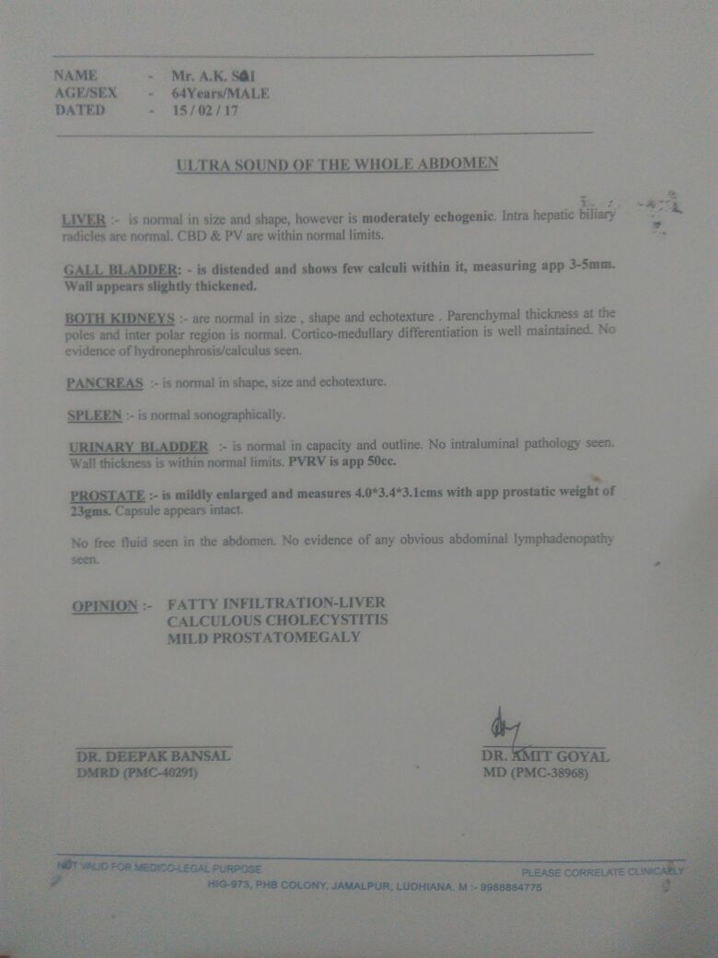
Gall Bladder Stone
Treatment Continue ….
Before - Multiple tine calculi
During Treatment – Few Calculi 3-5 mm

Slide 30
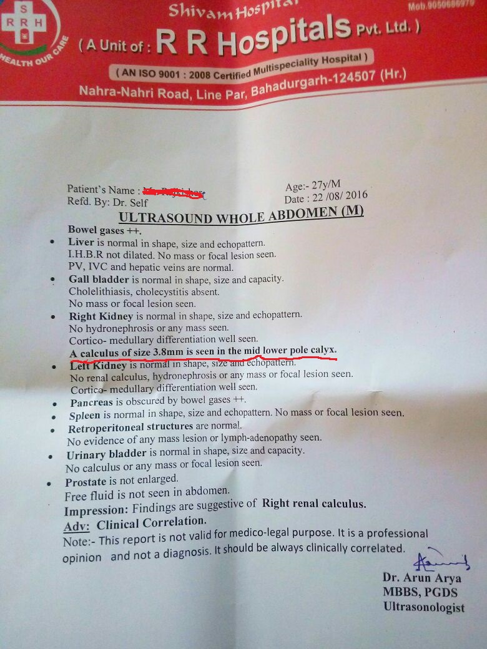
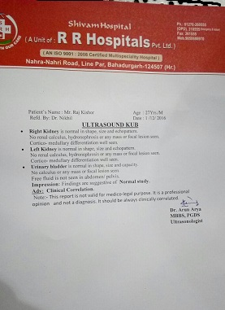
Kidney Stone
Before After
Rt. K. 3.8 mm Calculus
No Stone detected

Slide 31
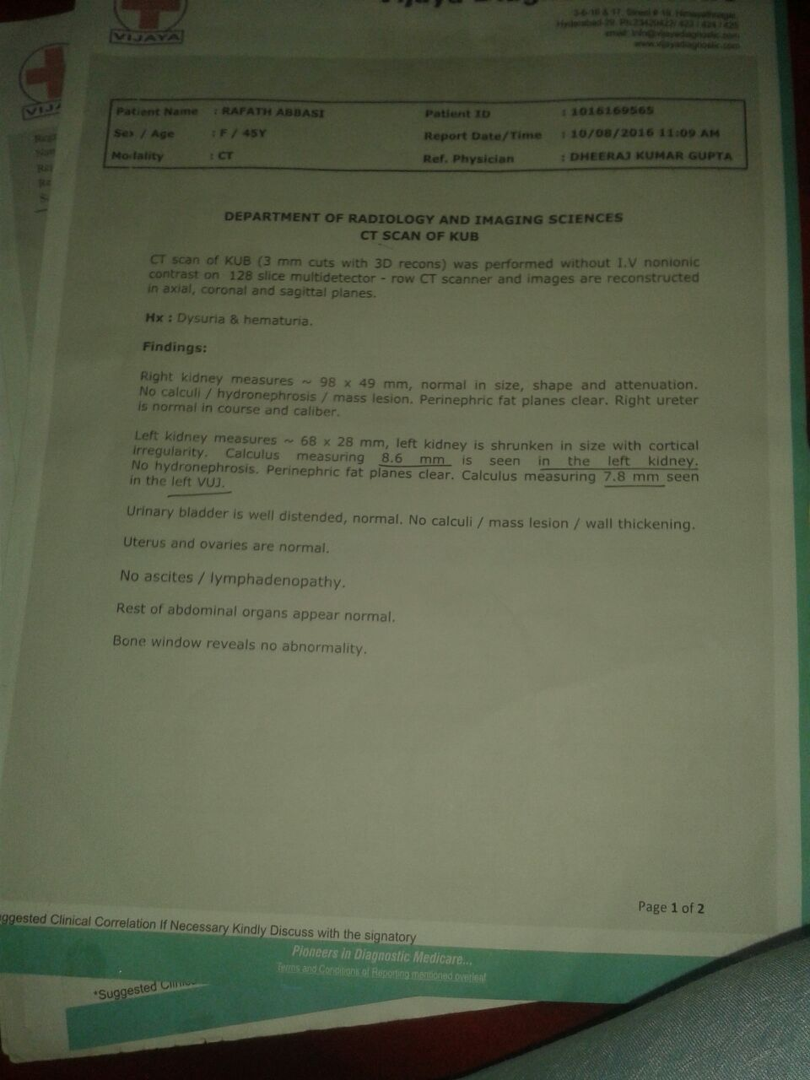
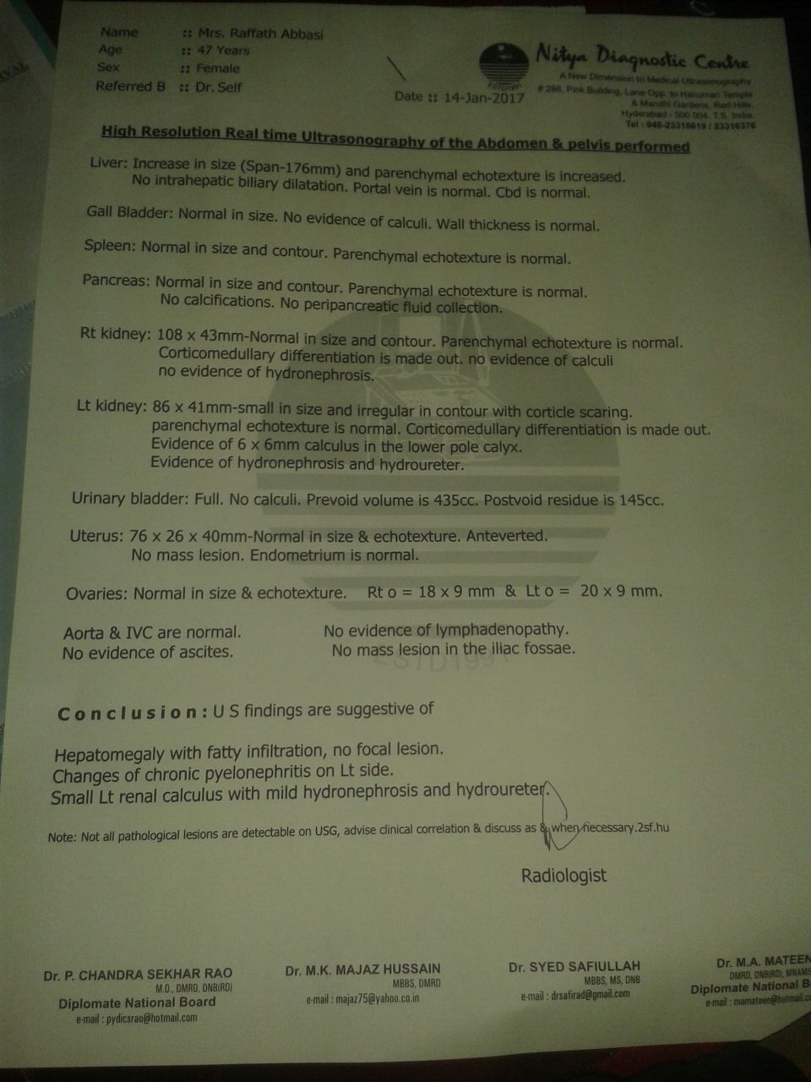
Kidney Stone
Before During Treatment
Left Kidney – 8.6 mm and 7.6 mm
Left Kidney – One Stone 6x6 mm

Slide 32
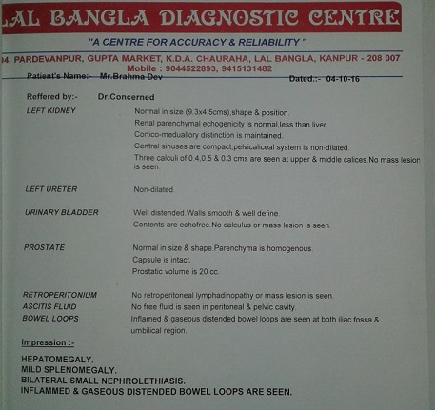
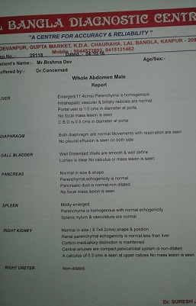
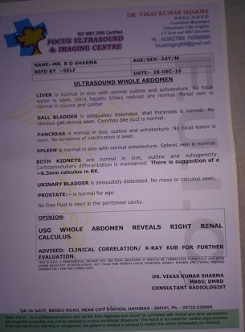
Kidney Stone – Treatment Continue..
Rt. Kidney – 0.3 cms and Lt. Kid. 0.3, 0.4 and 0.5 cms –
3 Calculi
Rt. Kidney 6.3 mm
Lt. Kid. No Calculi

Slide 33
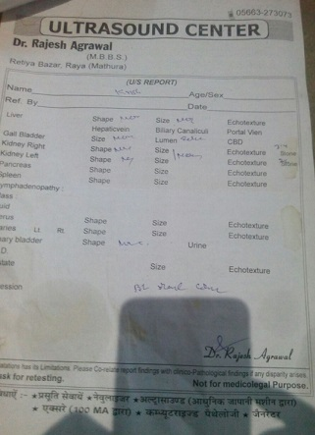
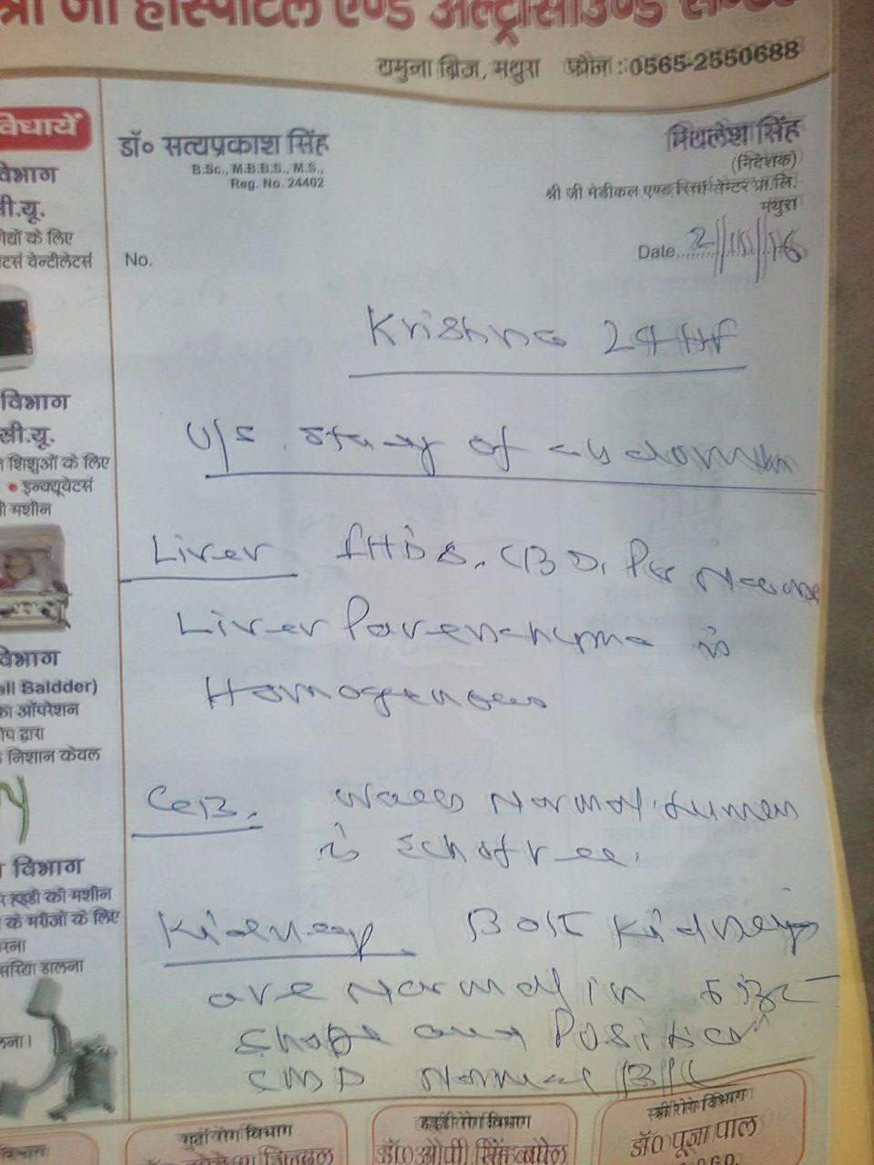
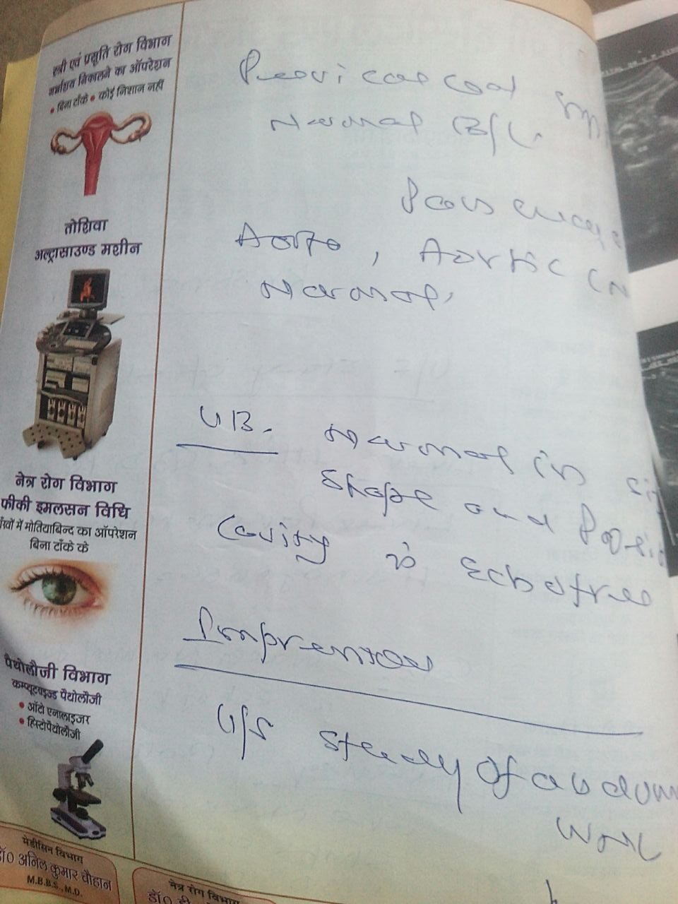
Kidney Stone
Before After
Bilat. Stone Rt. 3.4 mm
Lt. 2.6 mm
No Stone detected in USG after 2 months

Slide 34
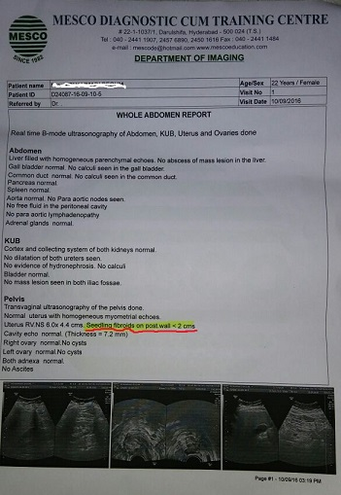
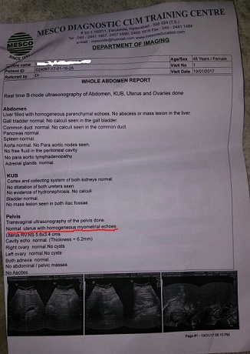
Uterine Fibroid
Before After

Slide 35
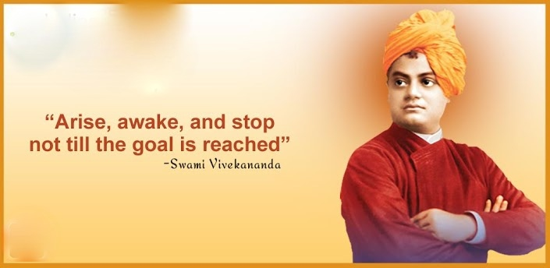
Fill the brain with high thoughts, highest ideals place them day and night before you and out of that will come great work.

Slide 36

THANKS

